Slide 1
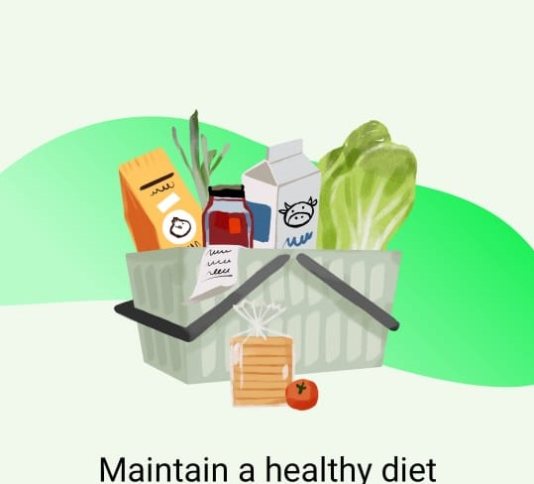
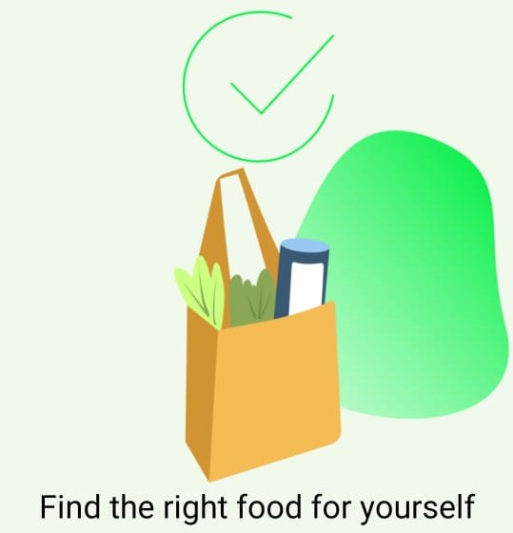
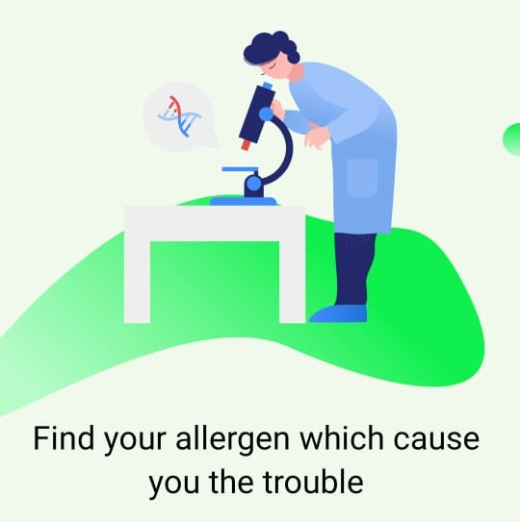
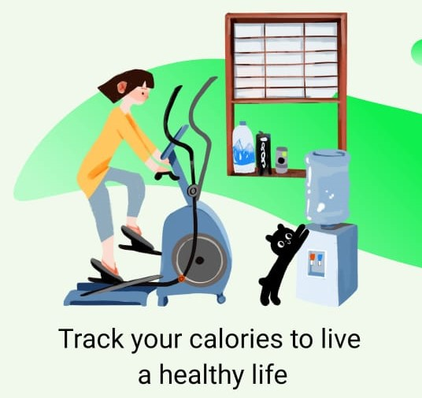
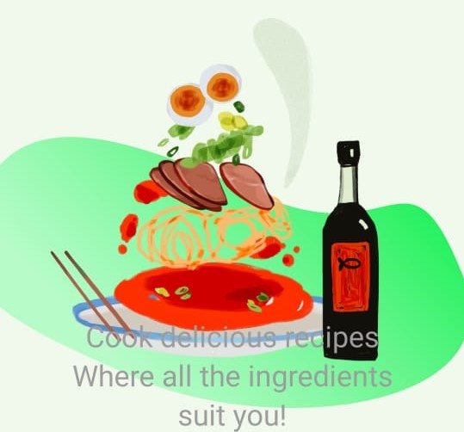
Health App: Food Allergy Prevention, Non-communicable Diseases Prediction, and Calories Tracker
Project ID: 2022-241

Slide 2
Supervisor: Ms. Manori Gamage
Co-Supervisor: Ms. Chathurangika Kahandawaarachchi
Group Members:
Nawarathne I.K.S.S. | IT19213972
Ahamed M.F.A | IT19111070
Muhassan Faizal | IT19212050
Chirathma V G B | IT19218090

Slide 3
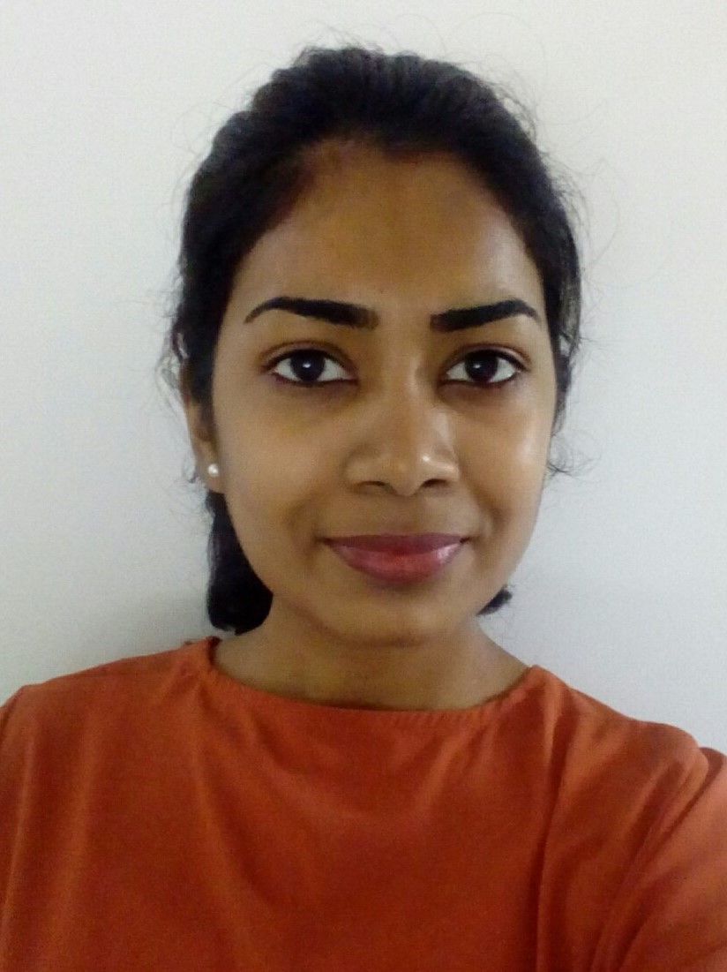
Nawarathne I.K.S.S. | IT19213972
Individual Component:
Prediction of the user’s Allergy and Allergens that caused the Allergy by analyzing the Symptoms and Food Items entered by the user

Slide 4
Overall Component Explained
The overall strategy of my component is centralized with the user. As per the methodologies and processes mentioned above, this is ideal for those unaware of their allergies and allergens. The planned system has User Interfaces to enter the food items consumed within 12 hours (Assuming he has a food allergy). According to the sources, the allergic reaction symptoms of a food allergy may occur between a few minutes and two hours after exposure to the food item. The next step shall include the symptoms tracking process. The user may already have some symptoms due to an allergic reaction concerning the above theorem. Therefore, the following interface shall have a list of symptoms, and the user can select the symptoms they might have felt that day. These symptoms will be filtered upon entering the food items.
After analyzing these entered details, the system shall predict the allergen/food item/ food type that caused the allergy. These records will be taken into consideration because tracking both the food intake and allergy symptoms makes it much easier to figure out what is causing the allergies and the outcome of the allergic reactions. Since it will take 1 to 3 weeks to entirely vanish the signs of an allergic reaction, the user should continue the process for at least three weeks to get the most out of the proposed application. During this time, the user can eliminate the system-predicted food items from the diet plan and follow the tips and precautions/remedies provided through the application to stay healthy and free from Food Allergies
IT19213972 | Nawarathne I.K.S.S | 2022-241 | Progress presentation2

Slide 5
Objectives
The main objective of implementing this component is to detect and predict food allergy and the allergens caused the allergy by analyzing the food items consumed, tracking prevailing signs and symptoms entered by the user within 12 hours, for three weeks.
Specific Objectives:
Elimination of Allergens - It is likely to be affected if frequently consumed food items are within the 'big eight'; the eight food groups responsible for 90% of food allergy reactions. Once the food item is predicted, it can be eliminated. This elimination of Allergens involves removing a particular food from the user's diet for two weeks.
Symptom Tracking - The user can select their prevailing symptoms from a list of medical symptoms provided through the app (medical symptoms will be filtered concerning the food items entered into the system) and record them as part of the prediction. Users can record the details as needed in the symptoms section of check-in for three weeks.
IT19213972 | Nawarathne I.K.S.S | 2022-241 | Progress presentation2

Slide 6
Objectives
3. Informed decision making - The user can become an active participant in any Allergy-healthcare decision, feeling empowered to discuss procedures, self-diagnoses, and treatments with various healthcare specialists as the app provides 95% accurate medical decisions.
4. Generation of PDF reports - The reports may contain information such as the system predicted food item/allergens, symptoms entered by the user, any other relevant symptoms (detected by the application itself), the system predicted allergy, quick remedies to be taken, and outcomes. These reports can help users discover triggers or help them stay on track to minimize symptoms based on the allergy & allergens.
IT19213972 | Nawarathne I.K.S.S | 2022-241 | Progress presentation2

Slide 7
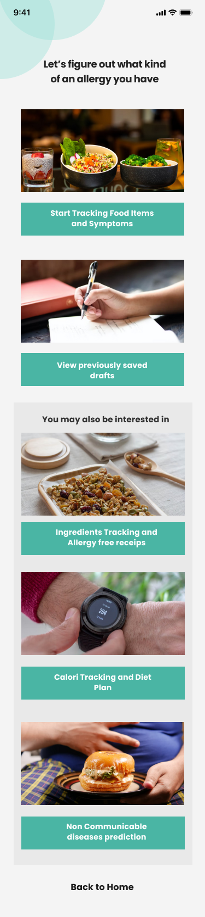
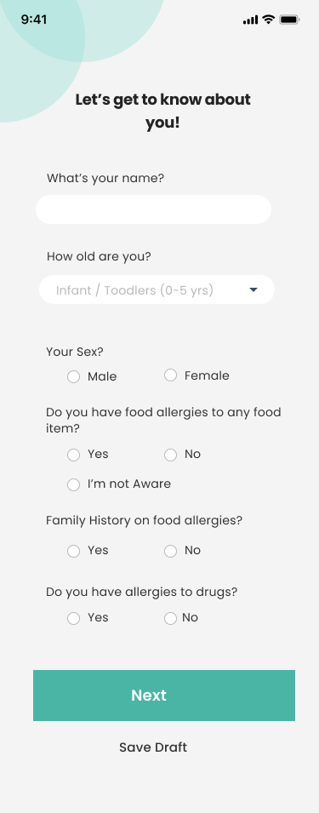
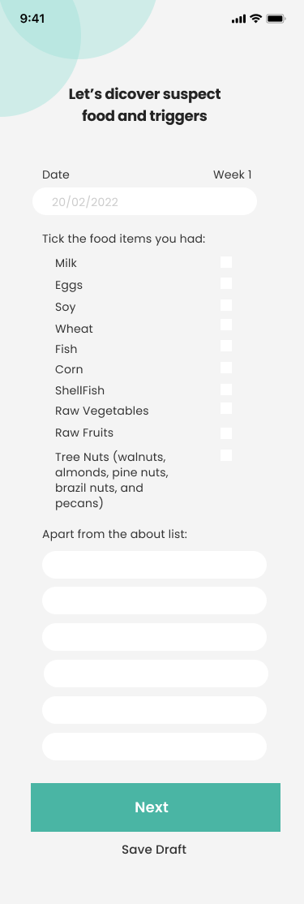
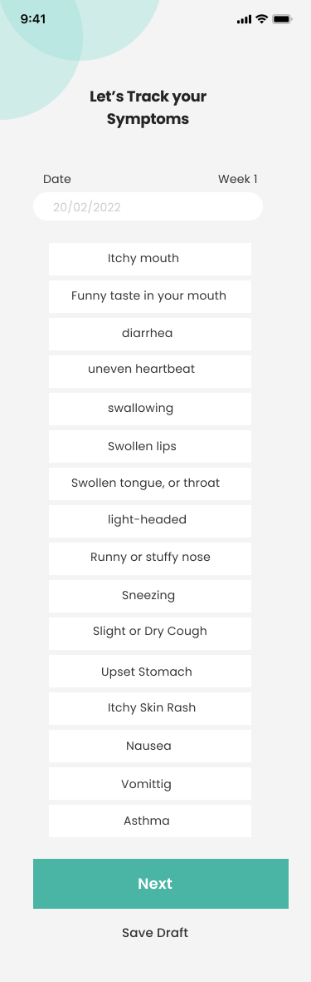
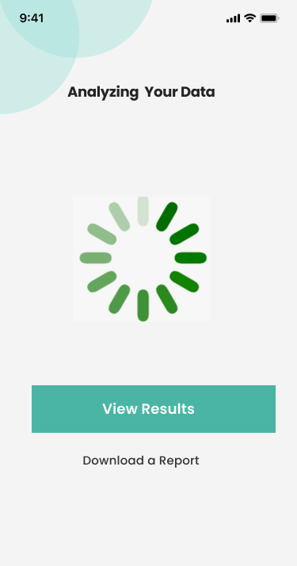
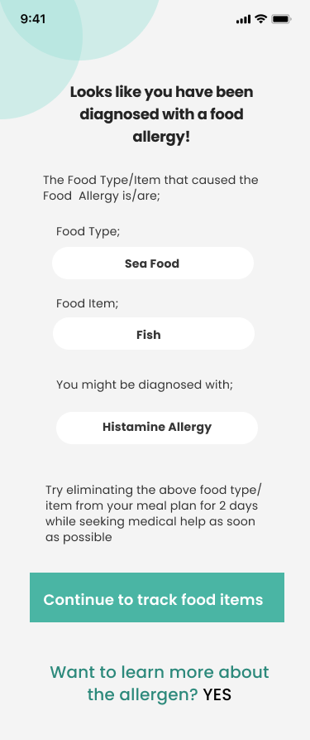
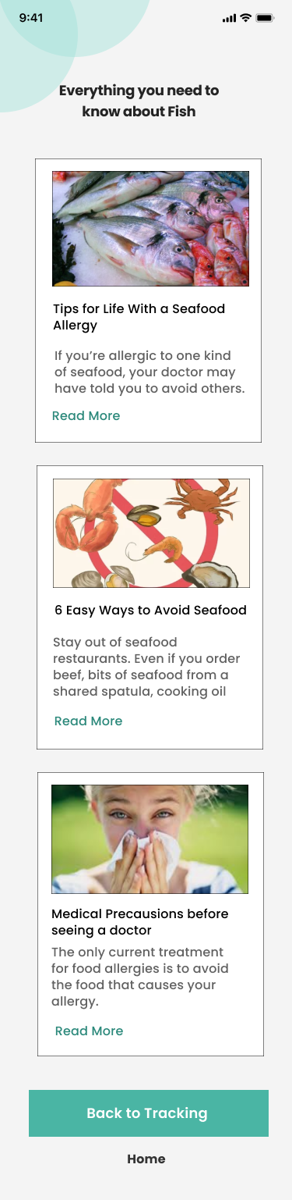
Figma Prototypes of the User Interfaces
Analyzing Data
OutPut
IT19213972 | Nawarathne I.K.S.S | 2022-241 | Progress presentation2
Symptoms
Tracking

Slide 8
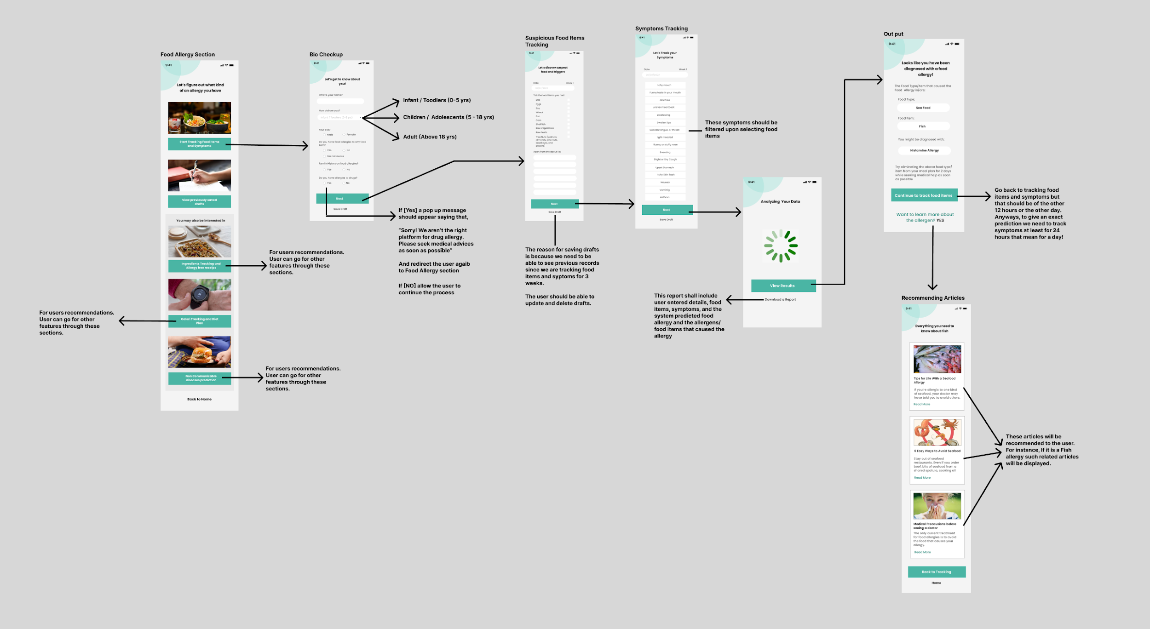
Interface Flow
IT19213972 | Nawarathne I.K.S.S | 2022-241 | Progress presentation1

Slide 9
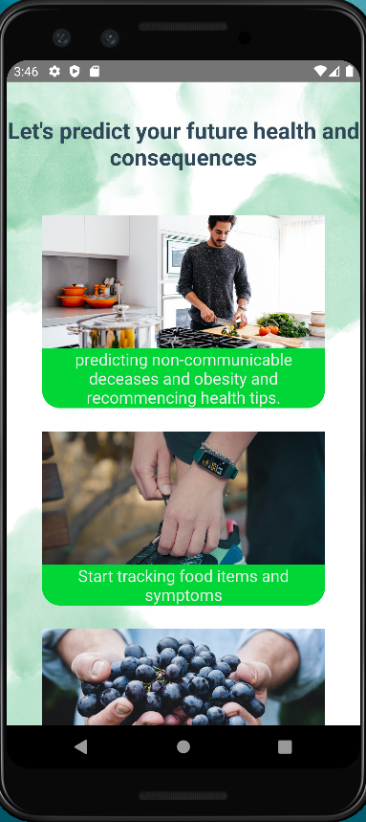
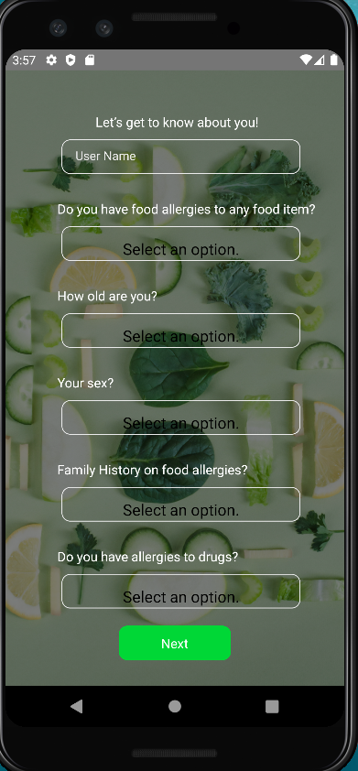
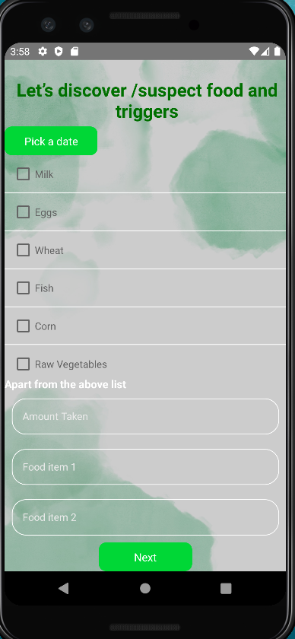
Front End UI

Slide 10
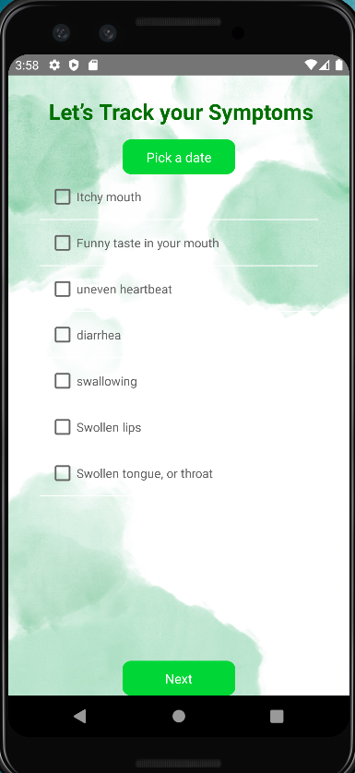
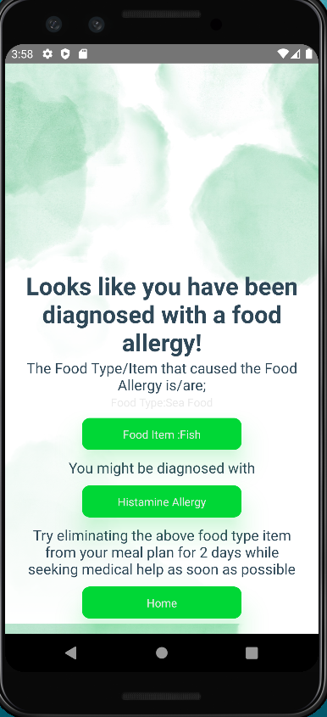
Front End UI (Cont.)

Slide 11
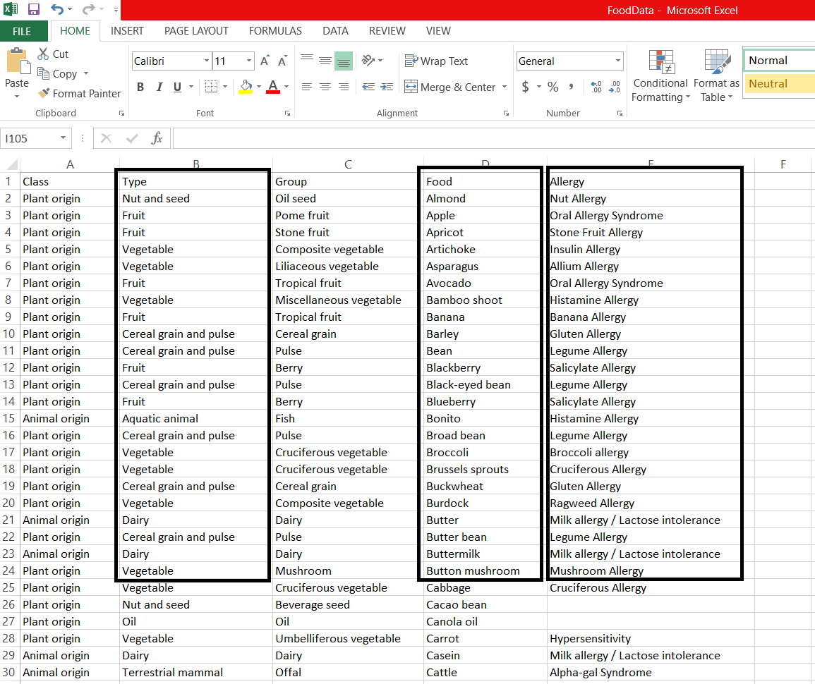
Data Set (cont.)
Finding a proper dataset was quite a challenging task. I searched Kaggle, Google scholar, and many other sites for a dataset related to food allergies and relevant food items. Luckily I found a dataset that includes several food items and the medical/identical name for the allergy caused by the given food type. I extracted three columns from that dataset and prepared the my dataset with the help of our external supervisor Dr. Ridmika Senevirathne and her colleague Gayani Perera, a nutritionist.
Data columns which were taken from Kaggle dataset are: Food Type, Food Item and Allergy
Food data: Resource; Kaggle
IT19213972 | Nawarathne I.K.S.S | 2022-241 | Progress presentation2

Slide 12
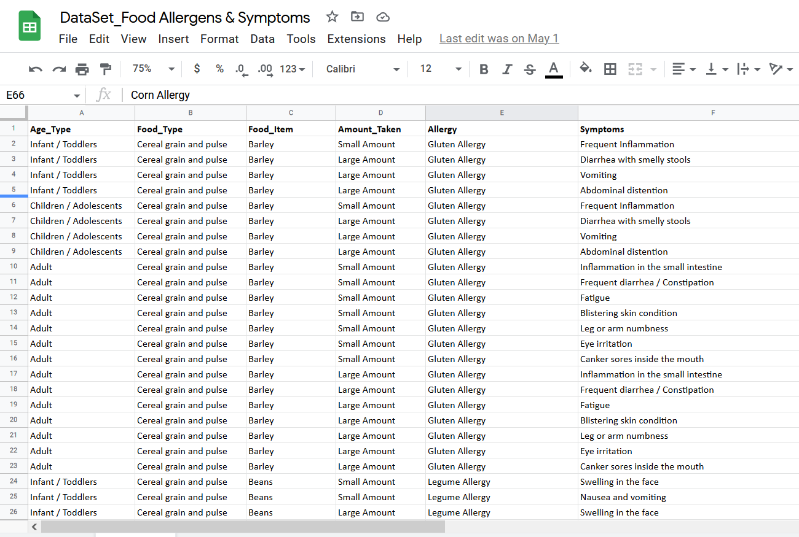
Data Set
For a better accuracy and easiness, I have taken 3 main age types as follows,
Infant / Toddlers (0 - 5 yrs)
Children / Adolescents (5 - 18 yrs)
Adult (above 18 yrs)
Also, when predicting the allergen we have to consider the amount of the food item taken. Therefore the “Amount Taken” will also be taken as an user input when doing a bio checkup.
Prepared Dataset
IT19213972 | Nawarathne I.K.S.S | 2022-241 | Progress presentation2

Slide 13
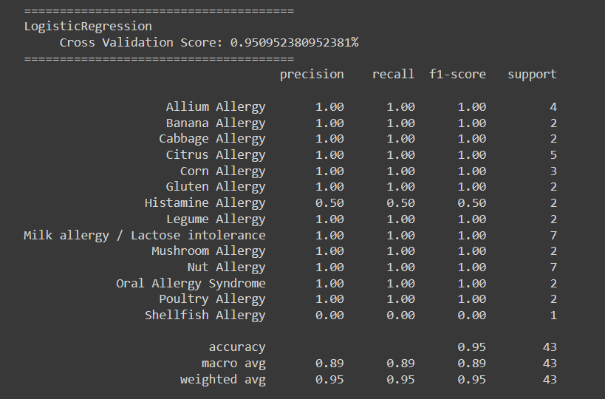
Model Selection
Five main models were taken into consideration.
LogisticRegression
KNeighborsClassifier
RandomForestClassifier
DecisionTreeClassifier
GaussianNB
Model selection using LogisticRegression
IT19213972 | Nawarathne I.K.S.S | 2022-241 | Progress presentation2

Slide 14


Model selection using KNeighborsClassifier
Model selection using RandomForestClassifier
IT19213972 | Nawarathne I.K.S.S | 2022-241 | Progress presentation2

Slide 15
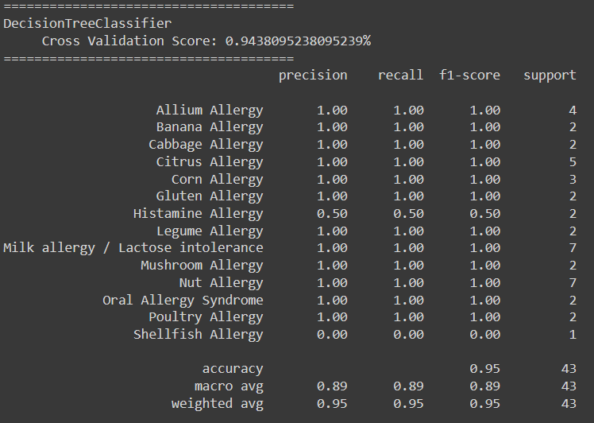
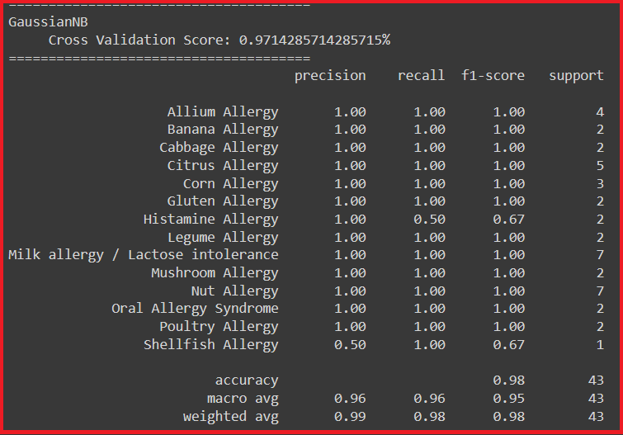
Model selection using DecisionTreeClassifier
Model selection using GaussianNB
IT19213972 | Nawarathne I.K.S.S | 2022-241 | Progress presentation1

Slide 16
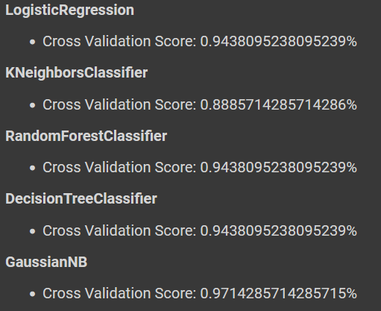
Model Selection (cont.)
F1-Score: A good F1 score means that you have low false positives and low false negatives, so you're correctly identifying real threats and you are not disturbed by false alarms. An F1 score is considered perfect when it's 1
Precision: should ideally be 1 (high) for a good classifier
Recall: should ideally be 1 (high) for a good classifier
IT19213972 | Nawarathne I.K.S.S | 2022-241 | Progress presentation2

Slide 17
Model Selection - Food Allergy Prediction
Cross-validation, F1 Score, Precision, and Recall is primarily used in applied machine learning to estimate the skill of a machine learning model on unseen data. According to the evaluation LogisticRegression, RandomForest, and GaussianNB classifiers performed well. By considering the cross validation score and other factors, GaussianNB was chosen for final model.
IT19213972 | Nawarathne I.K.S.S | 2022-241 | Progress presentation2

Slide 18
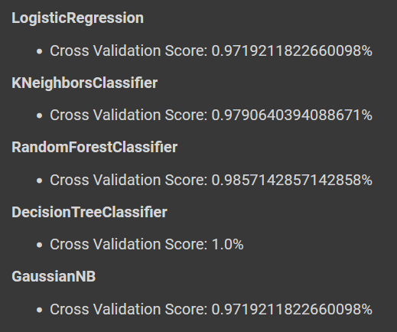
Model Selection - Food Type Prediction
Cross-validation, F1 Score, Precision, and Recall is primarily used in applied machine learning to estimate the skill of a machine learning model on unseen data. According to the evaluation Tree-Based Classifiers performed well. So, DecisionTreeClassifier was chosen for final model.
IT19213972 | Nawarathne I.K.S.S | 2022-241 | Progress presentation2

Slide 19
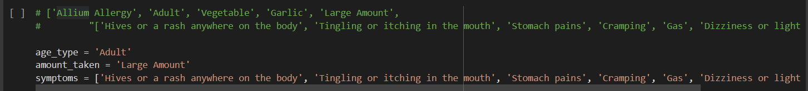
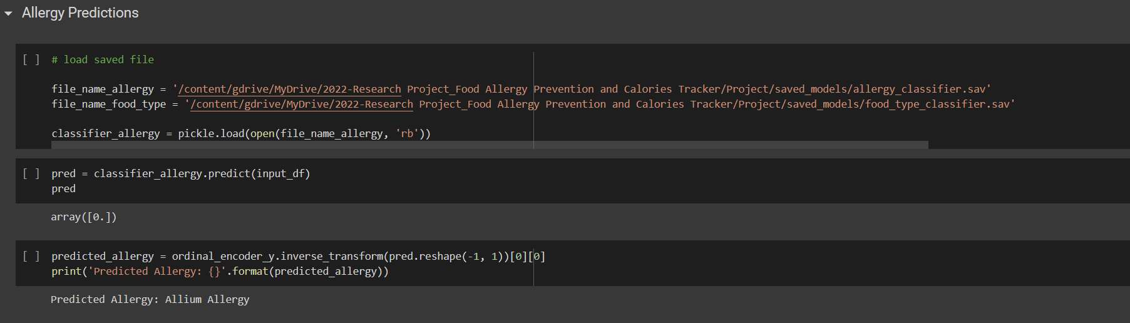
Real World Test
IT19213972 | Nawarathne I.K.S.S | 2022-241 | Progress presentation2

Slide 20
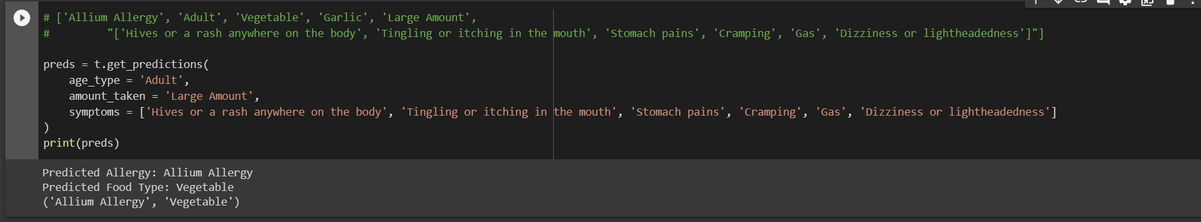
For now, only the food allergy and the food type is predicted. I’m planning on implementing food item prediction also.
IT19213972 | Nawarathne I.K.S.S | 2022-241 | Progress presentation2

Slide 21
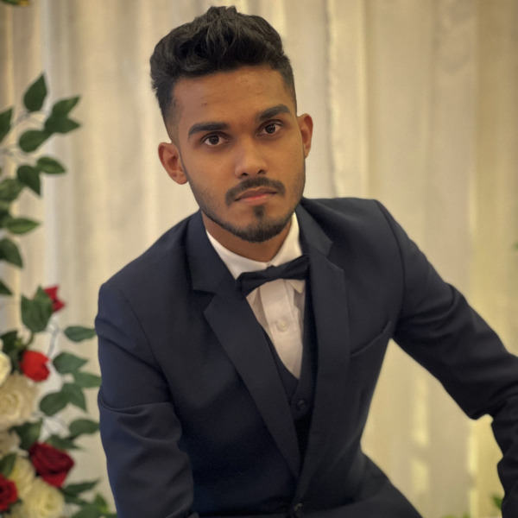
Ahamed M.F.A | IT19111070
Individual Component:
Allergy Free Recipe and Food Restriction App

Slide 22

Research Problem
Food Lovers Who have Allergy wants to taste the food Everyone enjoying
People want safety Food Recipes which not go against their beliefs
Connecting the people with same allergy
IT19111070 | M.F.A Ahamed | 2022-241 | Progress presentation2

Slide 23
Overall Component Explained
Establish an Allergy free food app that Predict Recipes which does not contain Allergens and have functions such as searching Allergens and finding Recipes of Food Items, share known Recipe to others in Forum, Specify the Recipe by Food preference such as Halal, Kosher and Vegan
IT19111070 | M.F.A Ahamed | 2022-241 | Progress presentation2

Slide 24
Specific Objectives
Create a Forum to active discussion
The purpose of this platform is to engage people around the world to engage and ask doubts and questions of food allergy and post their recipes which does not contain the allergens. This enables sharing knowledge on food allergy and help people to aware of their Food Allergen. And have voting system to display the reliability of the content
Profile for User
There are people with different Food Allergens, and they have their own specific Allergies, so we must customize them for the user. The profile will take user details of food allergy. This help user to identify other user through the forum and it’s easy to make a specific suggestion according to user Allergy
IT19111070 | M.F.A Ahamed | 2022-241 | Progress presentation2

Slide 25
Specific Objectives
Process Accurate Recipes
In our method, a food context and allergy-free substitute ingredients are extracted from known food recipes, and they are attached to unknown food recipes based on the similarity between recipes
Food Restriction Filter System
The purpose of this component is to avoid the user's food restrictions among the allergy free food recipes. Each recipe is categorized into specific user’s food preferences. The user's preferred food restriction is avoided
IT19111070 | M.F.A Ahamed | 2022-241 | Progress presentation2

Slide 26
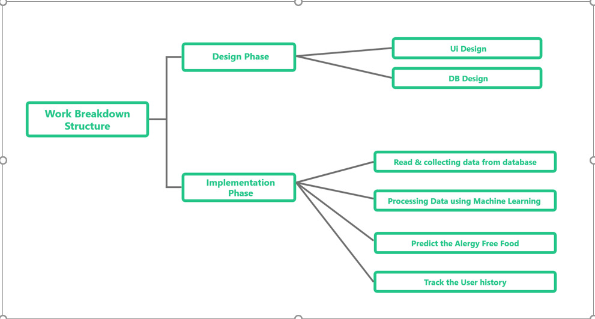
Work Breakdown Structure
IT19111070 | M.F.A Ahamed | 2022-241 | Progress presentation2

Slide 27
Technologies Used
React Native 4. Nodejs
Machine Learning 5. Python
Firebase
Application of Technologies
Firebase | Realtime database. Managing The Forum Discussion
Machine Learning | Processing the data set and classify the food recipes
React native | Creating mobile app and the Interfaces
Node.js | Will be used to develop Backend functions
IT19111070 | M.F.A Ahamed | 2022-241 | Progress presentation2

Slide 28
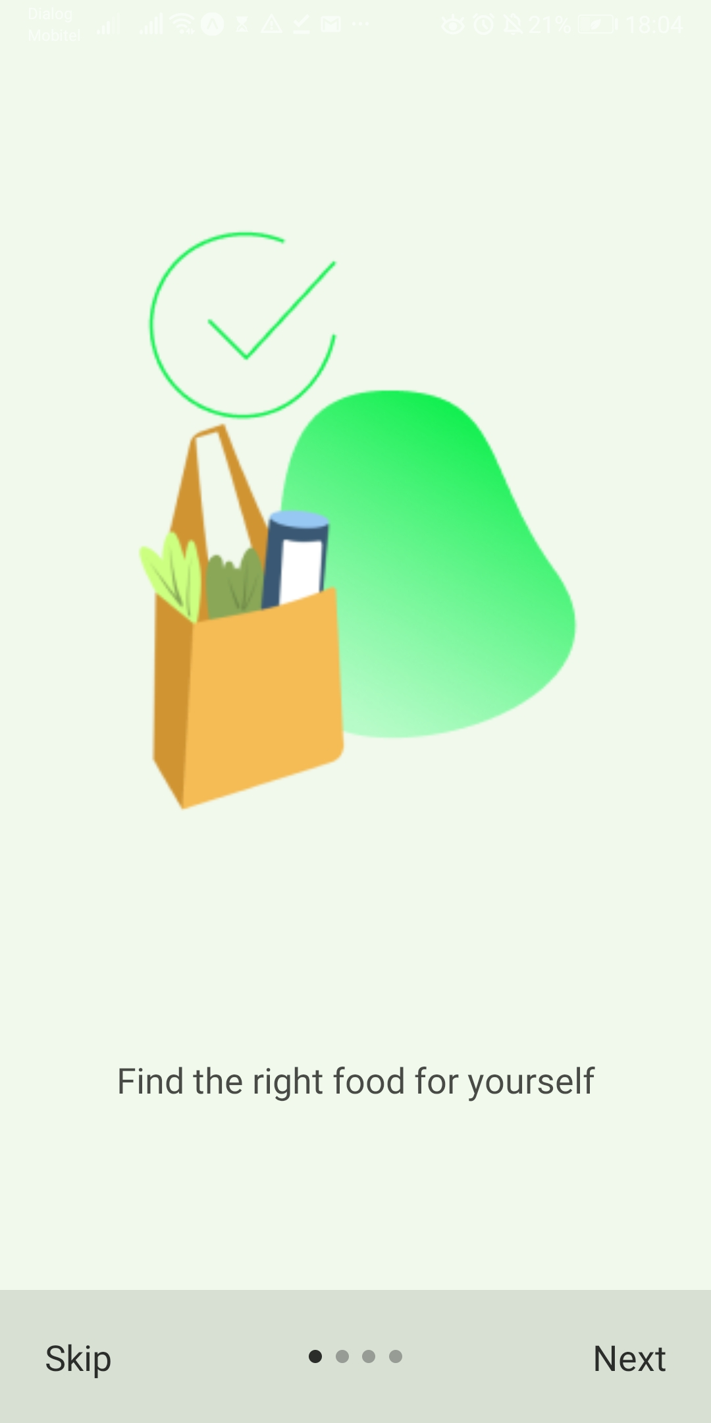
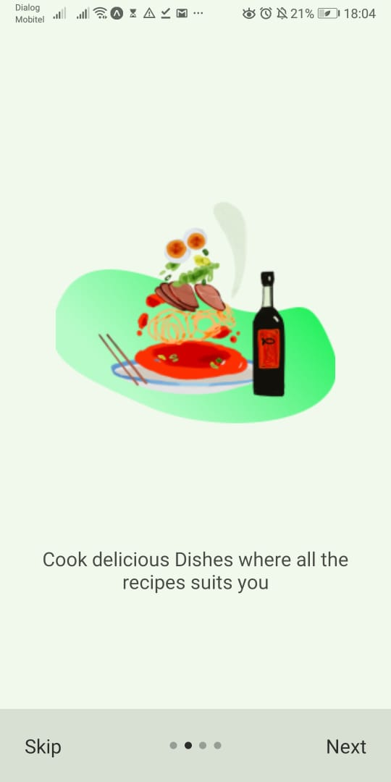
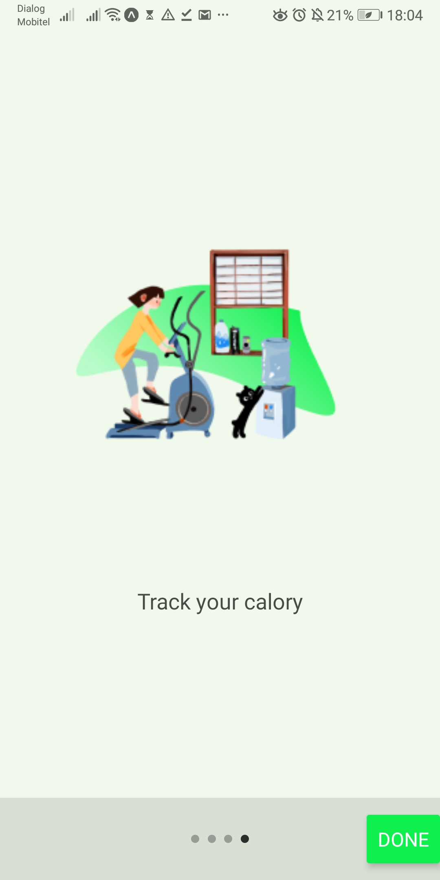
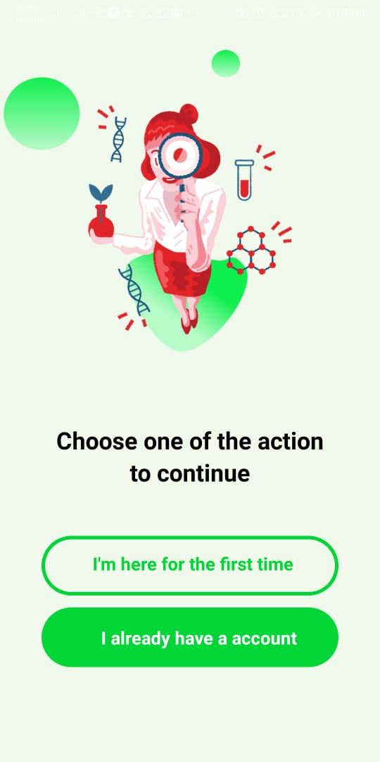
User Interfaces - React Native
IT19111070 | M.F.A Ahamed | 2022-241 | Progress presentation2

Slide 29
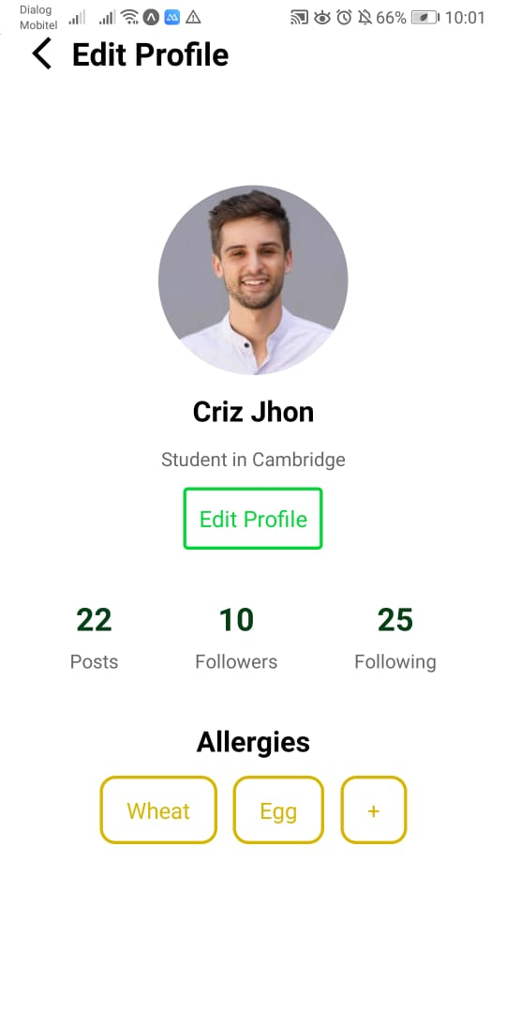
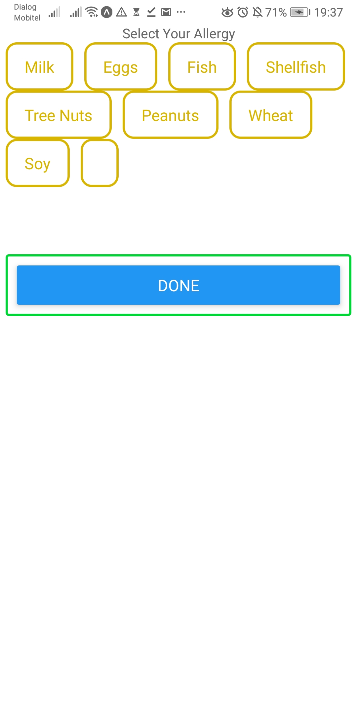
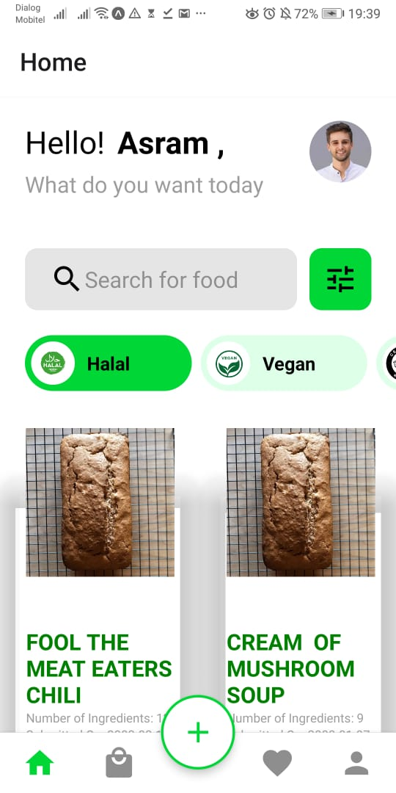
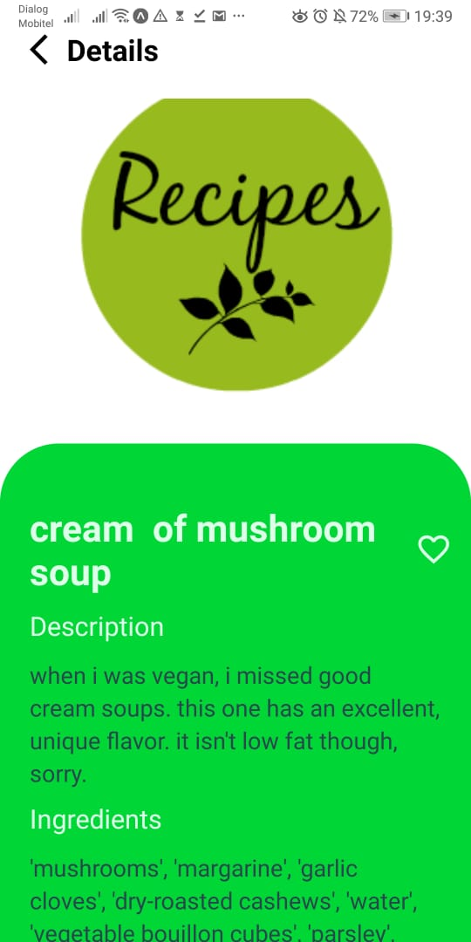
User Interfaces - React Native
IT19111070 | M.F.A Ahamed | 2022-241 | Progress presentation2

Slide 30
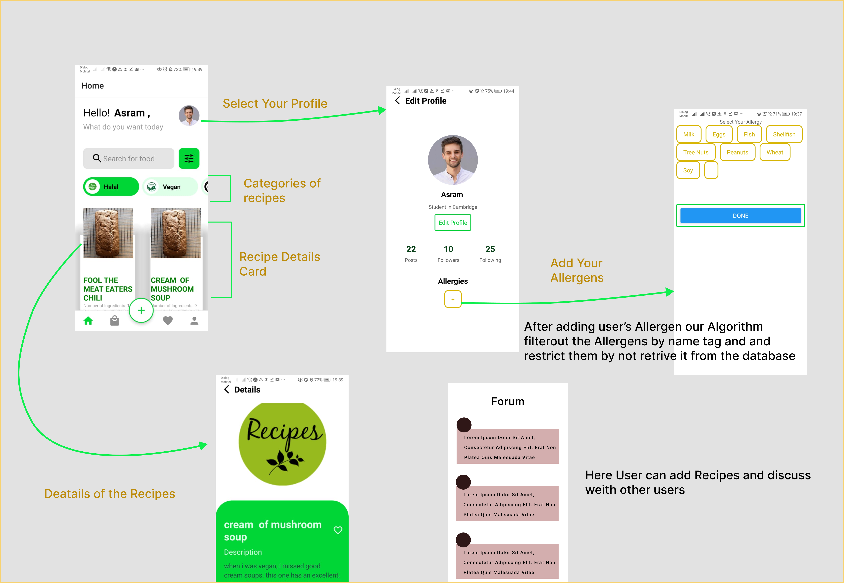
User Interfaces Flow
IT19111070 | M.F.A Ahamed | 2022-241 | Progress presentation2

Slide 31
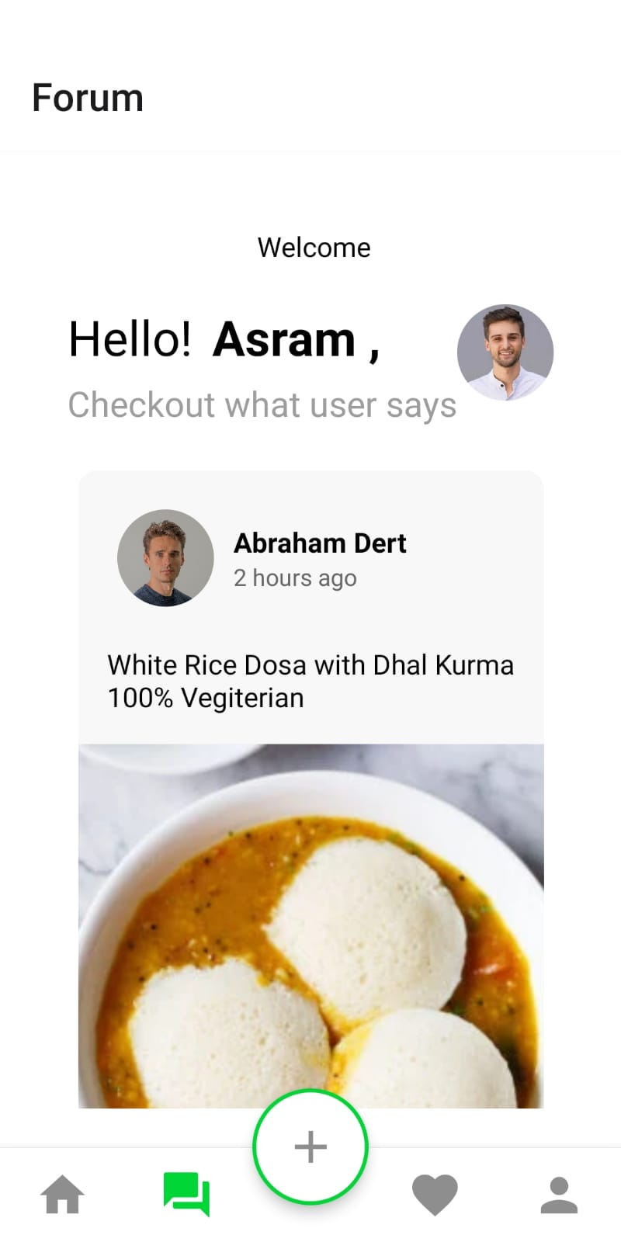
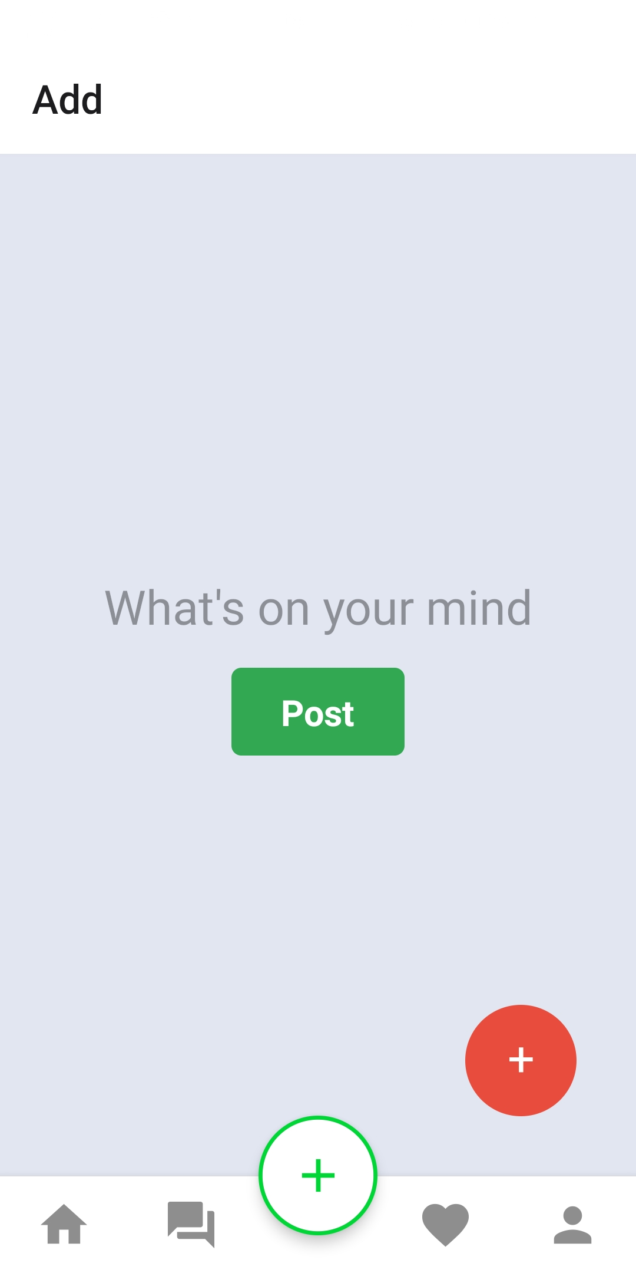
User Interfaces Flow
User Can Add Post in the forum for the discussion
User Can Add Post in the forum for the discussion
IT19111070 | M.F.A Ahamed | 2022-241 | Progress presentation2

Slide 32
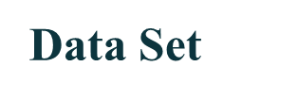
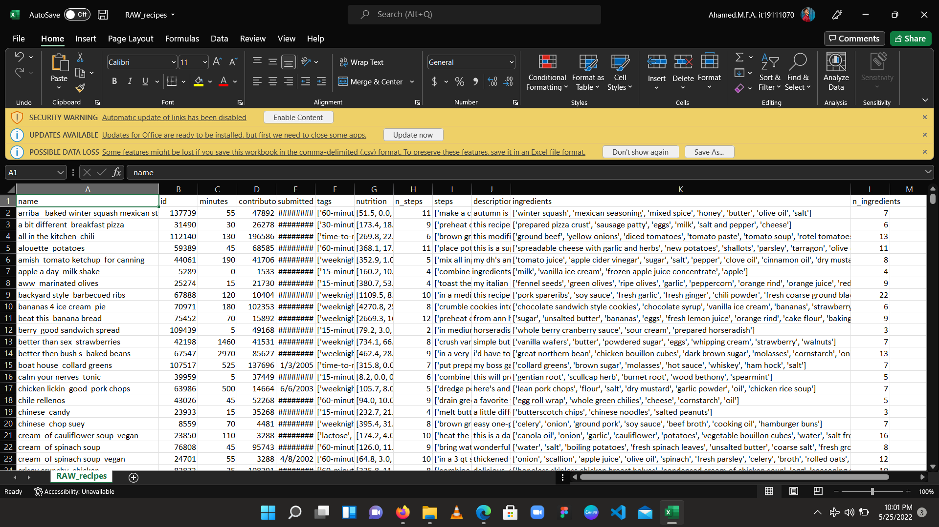
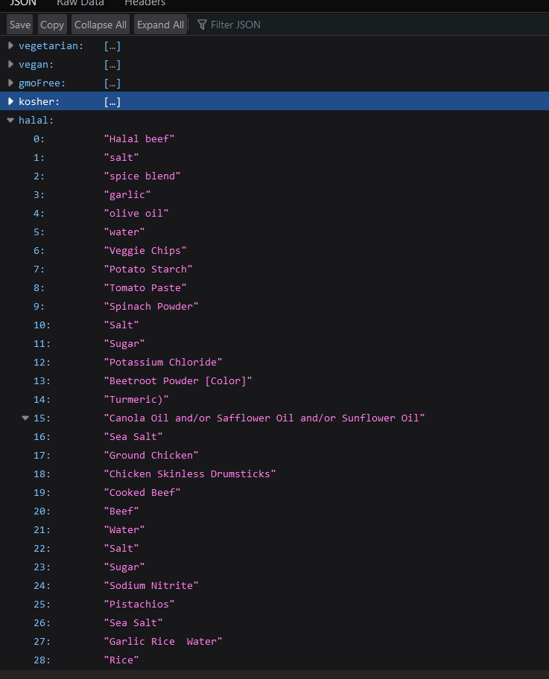
Data set which is needed for my component is Foods with recipes and i have searched in many websites and found the data set from KEGGLE and its really page scrapped datas Food.com website
This recipes are with user reviews
Recipes have the calories
IT19111070 | M.F.A Ahamed | 2022-241 | Progress presentation2

Slide 33
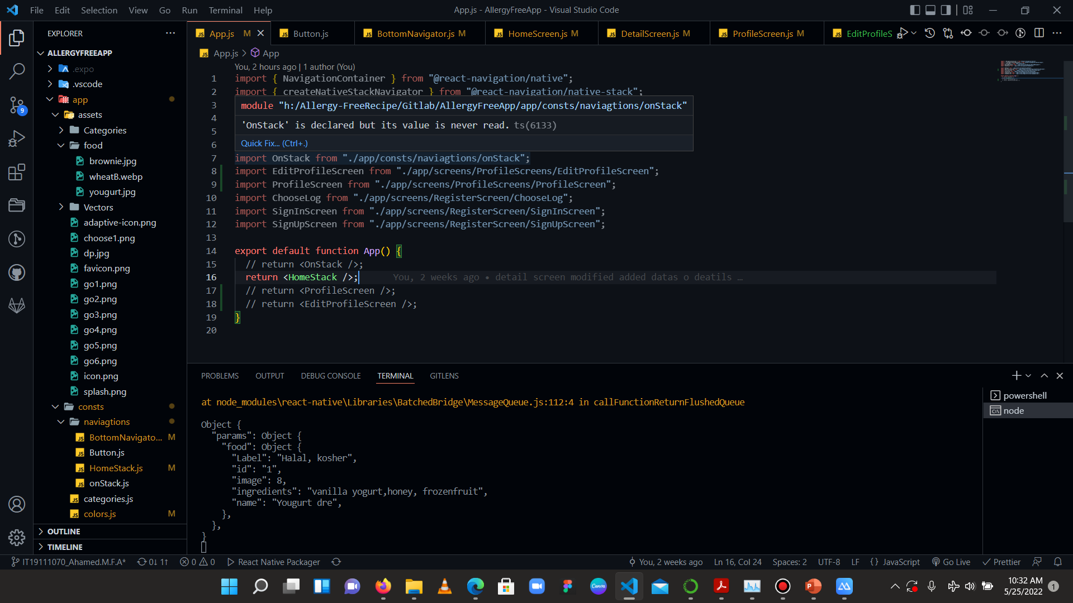
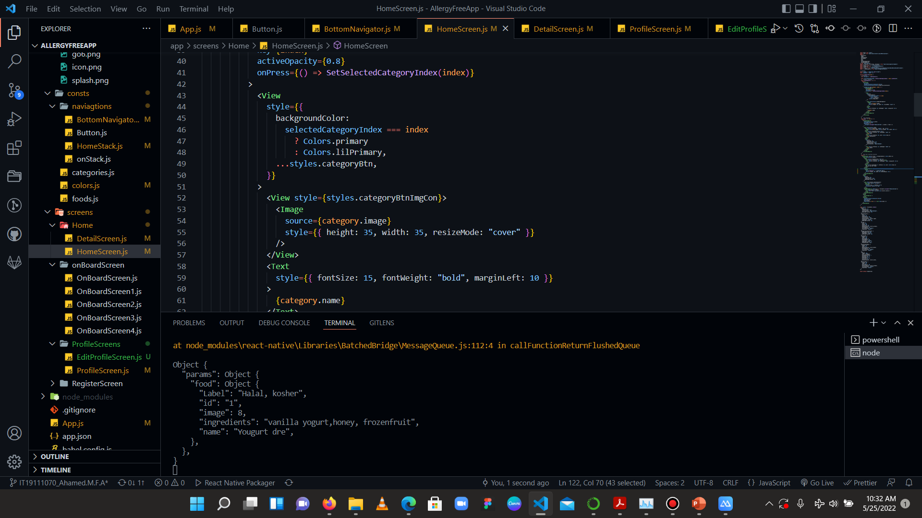
Completion of App Interfaces
Mobile app Development using React native
IT19111070 | M.F.A Ahamed | 2022-241 | Progress presentation2

Slide 34
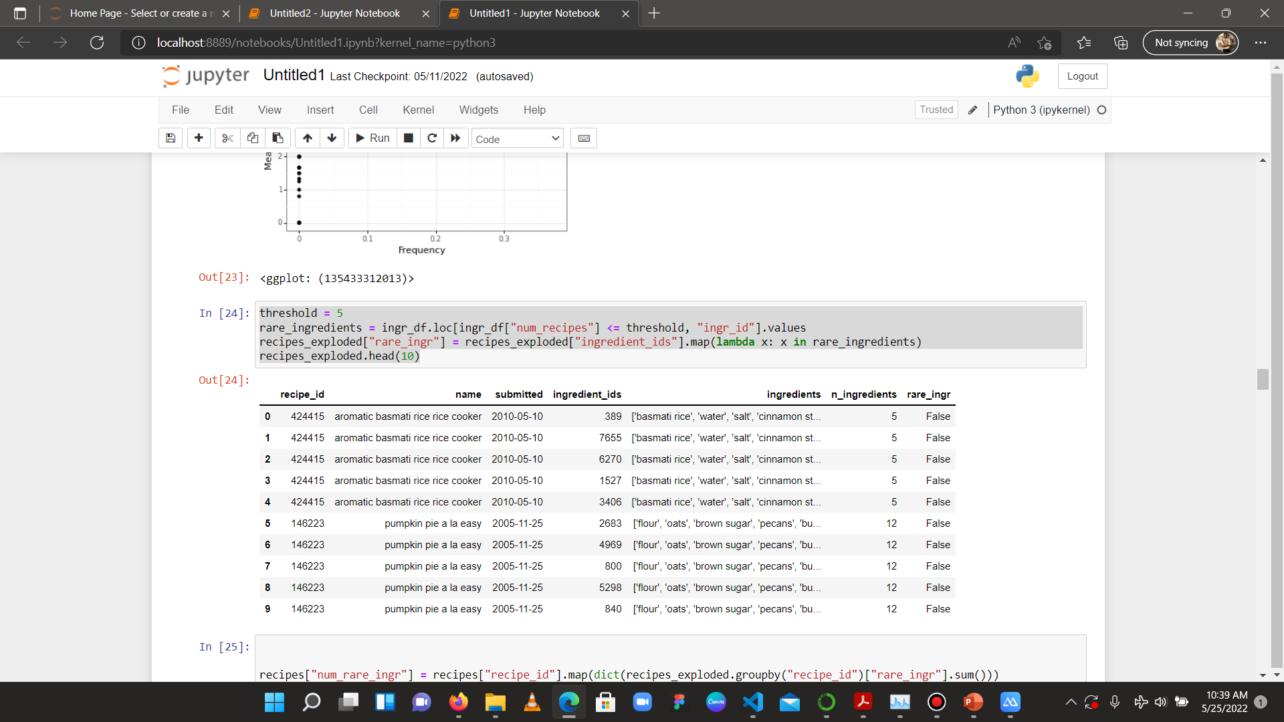
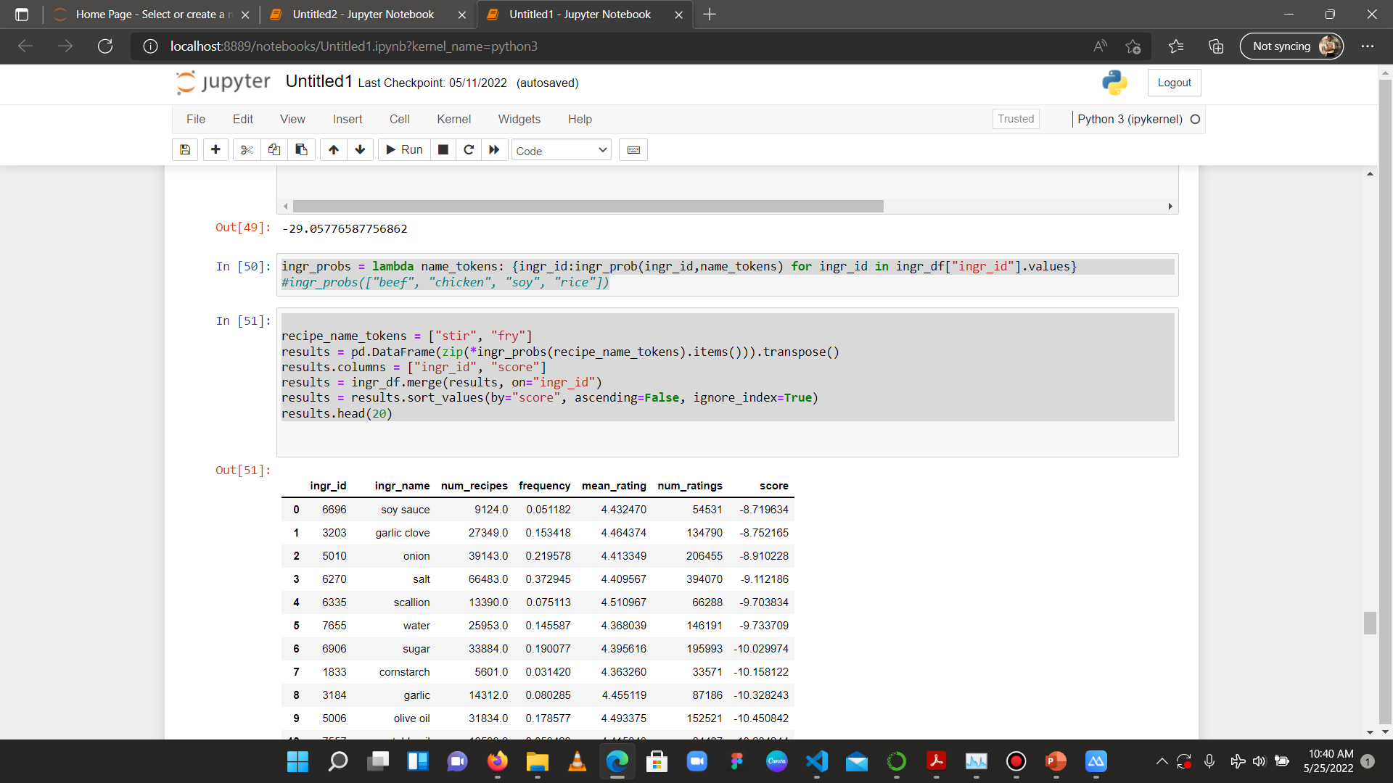
Completion of Model
Data analysis and model using Jupyter Notebook
IT19111070 | M.F.A Ahamed | 2022-241 | Progress presentation2

Slide 35
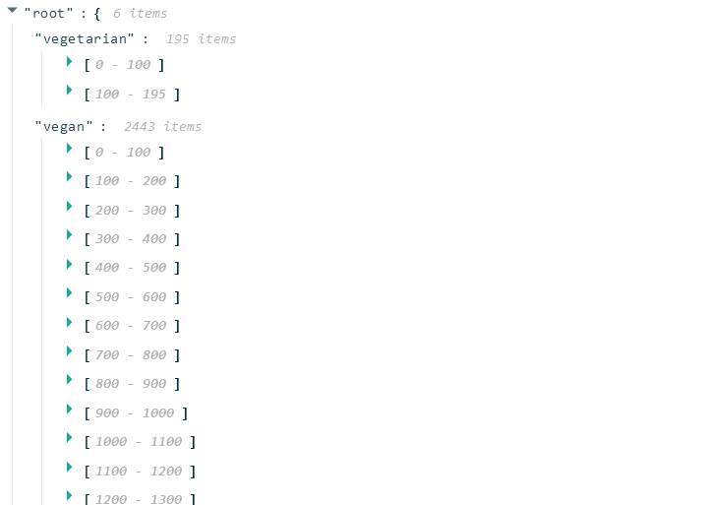



Completion of Model Cont..
Data Classification
(Vegetarian , Vegan, Kosher , Halal)
IT19111070 | M.F.A Ahamed | 2022-241 | Progress presentation2

Slide 36



Completion of Model
Classifying data veg, Non-veg Healthy
IT19111070 | M.F.A Ahamed | 2022-241 | Progress presentation2

Slide 37


Completed Work
Creation of Forum
Module connected with algorithm
Database connected with app
User Adding Allergens
User Adding Post for the Forum
IT19111070 | M.F.A Ahamed | 2022-241 | Progress presentation2

Slide 38
Risk Mitigation
Problem | How Did I Overcome It
Collecting the data | Found the data from Keggle and did some page scrape from trusted websites
Finding the suitable Algorithm | Discussed with seniors and then gone through lots of research papers
So many errors in developing | Asked from forums and then got help from seniors
IT19111070 | M.F.A Ahamed | 2022-241 | Progress presentation1

Slide 39

IT19212050 | Muhassan Faizal
Specialization in Information Technology
IT19212050 | Muhassan Faizal | 2022-241​

Slide 40

CALORIE MEASUREMENT
IT19212050 | Muhassan Faizal | 2022-241​

Slide 41
INTRODUCTION
Research Problem
Objectives
Methodology
Completion of the Project
Future Developments
IT19212050 | Muhassan Faizal | 2022-241​

Slide 42

Research Problem
In Sri Lanka it is difficult to find a meal plan and fitness goal application which is based on Sri Lankan foods.
Difficulty of adding manual details and barcode scanner methods.
Users did not think of their health.
IT19212050 | Muhassan Faizal | 2022-241​

Slide 43
Objectives
Main Objectives
The main objective is Checks the user’s meal plan (calorie count) and confirm the calorie count related to the fulfilment of the meal plan.
Sub - Objectives
Develop a camera function to the application ​
Measure the pixels counts and objects of an image
Analyze or count whether user has taken the recommended meal plan.
Send notifications regarding the analyzed results
IT19212050 | Muhassan Faizal | 2022-241​

Slide 44
METHODOLOGY
Methodology
Tools/Techniques and Technologies
IT19212050 | Muhassan Faizal | 2022-241​

Slide 45

Methodology
Create camera function.
Created image dataset and Labeled image
Detect Food Objects and count pixels.
Count total calorie count.
Send notification
IT19212050 | Muhassan Faizal | 2022-241​

Slide 46

Camera Function
At first stage images of food plates are captured by the users with the camera function that implemented in the mobile application.
Users capture these images according to limitations.
The user captures these images on to a suitable size by using a bounding box.
MobileNet

Slide 47



Create Image Dataset
Starts with 120 image dataset to more than 1000
Increased the dataset using data augmentation.
Split data set into training and testing
Training – 80%
Testing – 20%
IT19212050 | Muhassan Faizal | 2022-241​

Slide 48

Labeled Image
IT19212050 | Muhassan Faizal | 2022-241​

Slide 49

Detect Food Objects
Detect various food objects using object detection and segmentation (Sri Lankan foods).
Tried several techniques to detect various food types.
Using a pre trained model – ResNet 101.
Mask RCNN
IT19212050 | Muhassan Faizal | 2022-241​

Slide 50

Segmentation
Used segmentation method to identify foods that are on the plate respectively.
Trained a model to detect objects with the pixel counts
(Mask RCNN).
From that it gets the pixel count of that food objects area
Calorie Count = Per pixel calorie count * pixel count of food area.

Slide 51


Loss Model
Accuracy of the model

Slide 52

Work Completed
Developed a camera function with limitations.
Train two models for detect objects and for segmentation.
Count total calorie count.
Send notification to the user.

Slide 53





INTERFACES
IT19212050 | Muhassan Faizal | 2022-241​

Slide 54

Chirathma V G B | IT19218090
Individual Component:
Predicting the time it takes to become obese and the risk of developing non-communicable diseases based on the user's daily meal plan

Slide 55
Overall Component
This research aim is Predicting the time it takes to become obese and the risk of developing non-communicable diseases based on the user's daily meal plan. This app is very useful for the user.
The system takes user's details at the beginning(Age, Gender, Height, Weight, Job) . After that user can enter foods names he ate during the day. And also, if the user did some exercises or did some day-to-day activities, he must enter those activities also. The user must enter his meals and details about activities into the system for exactly one month. After a month the system does some process using formulas and technologies and shows the time it takes to become obese and predict the risk for contracting non-communicable diseases as a percentage according to the user's meal plan. furthermore, to prevent that obesity and diseases the system recommends healthy tips.

Slide 56
Main Objectives
Predicting the time it takes to become obese.
Predict the risk of developing non-communicable diseases based on the user's daily meal plan.

Slide 57
Absorb for Ninety Percent of the project
•Create a dataset.
•Predict the risk of developing non-communicable diseases
•Implement the System UI

Slide 58

Research gap
Below mentioned three mobile applications that same as my component
MyNetDiary
Noom
MyFitnessPal

Slide 59







Technologies
Deep Learning
TensorFlow
Scikit learn
Flask
Python
React Native

Slide 60

Dataset
Dataset 1 - This dataset contains details of the nutrients of food items.

Slide 61

Dataset 2 - This dataset contains the risk for the non-communicable diseases according to the user’s bio data and his eating pattern. (19286 rows)

Slide 62

Model
Model -Artificial Neural Network(ANN) of Linear Regression in Deep Learning
Algorithm- Artificial Feed Forward Neural Network
Regression equation- Mean Squared Error(MSE)
(A model is said to be stable even if wrong or unidentified data are inserted and not confusing the system.)

Slide 63


Slide 64


Slide 65


Slide 66




Figma Prototypes of the User Interfaces
1
2
3
4

Slide 67




Figma Prototypes of the User Interfaces
5
6
7
8

Slide 68


Frontend UI

Slide 69




Slide 70

Output of the process

Slide 71


References
Dr. D.P. Hettiarachchi
MBBS, Msc in Human Nutritions
MO - Nutrition Incharge
Medical Nutrition Unit
Base hospital - A
Watupitiwala

Slide 72


Slide 73



Slide 74
Thank You

